Slide 1
Chapter 7: More SQL
Notes:
This chapter describes more advanced features of the SQL language for relational databases.

Slide 2
Content
More complex features of SQL retrieval queries
Nested queries aggregate functions, grouping
Defining VIEWs on the database
DROP and ALTER TABLE statement
CREATE ASSERTION statement, CREATW TRIGGER statement
Notes:
Create assertion: which allows the specification of more general constraints on the database
View: are also called virtual or derived tables because they present the user with what appear to be tables; however, the information in those tables is derived from previously defined tables.
ALTER TABLE: which is used for modifying the database tables and constraints

Slide 3
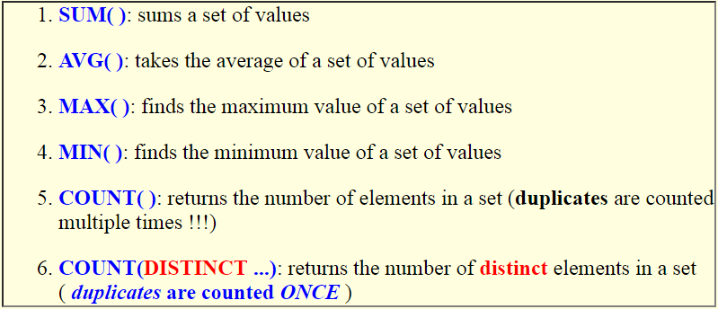
Aggregate Functions in SQL
Aggregate functions
Compute an aggregate value from a set of values
The aggregate functions available in SQL are:
Notes:
Aggregate functions are used to summarize information from multiple tuples into a single-tuple summary.
Grouping is used to create subgroups of tuples before summarization.

Slide 4
Applying Set of Function on a Set of Values
Syntax:
SELECT AggFunc( attribute )
Apply the aggregate function AggFunction on the selected set of tuples returned by the SELECT command
SELECT salary
FROM employee
SELECT SUM(salary), AVG(salary), MAX(salary),
MIN(salary), COUNT(salary), COUNT( DISTINCT salary )
FROM employee
SALARY
30000
40000
25000
43000
38000
25000
25000
55000
SUM(SALARY) AVG(SALARY) MAX(SALARY) MIN(SALARY) COUNT(SALARY) COUNT(DISTINCT salary)
281000 35125 55000 25000 8 6
Notes:
Fact: SELECT returns a set of tuples; We can therefore apply one or more aggregate functions on the result (set) of the SELECT command.
COUNT( ) will count duplicate values as multiple times; To count duplicate value once, use COUNT(DISTINCT ...)

Slide 5
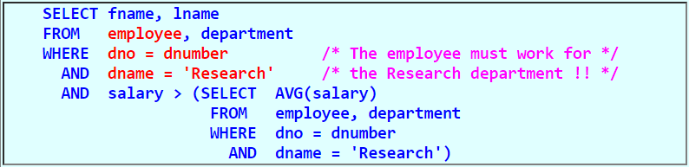
Using the Result of Aggregate Functions in Queries
Query
Find the fname and lname of the employee in the 'Research' department that earns more than the average salary within the 'Research' department
Reason:
The employee whose salary is greater than the average salary of the Research department, may:
SELECT fname, lname
FROM employee
WHERE salary > ( SELECT AVG(salary)
FROM employee, department
WHERE dno = dnumber AND dname = 'Research')
Correct?
No!
Notes:
These functions can also be used in selection conditions involving nested queries
We can specify a correlated nested query with an aggregate function, and then use the nested query in the WHERE clause of an outer query.

Slide 6
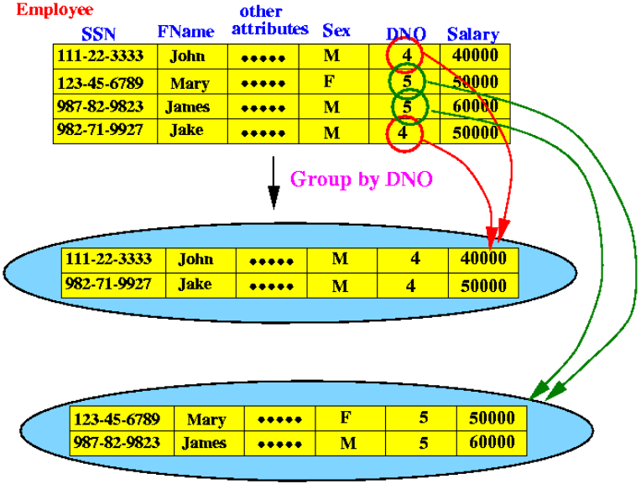
Forming Groups with Common Attribute Values: Grouping Attributes
Grouping is used to create subgroups of tuples before summarization
Forming groups by attribute values
Each group (partition) will consist of the tuples that have the same value of some attribute(s), called the grouping attribute(s).
Example: grouping employee tuples by their dno value:
Notes:
Examples: we may want to find the average salary of employees in each department; the number of employees who work on each project

Slide 7
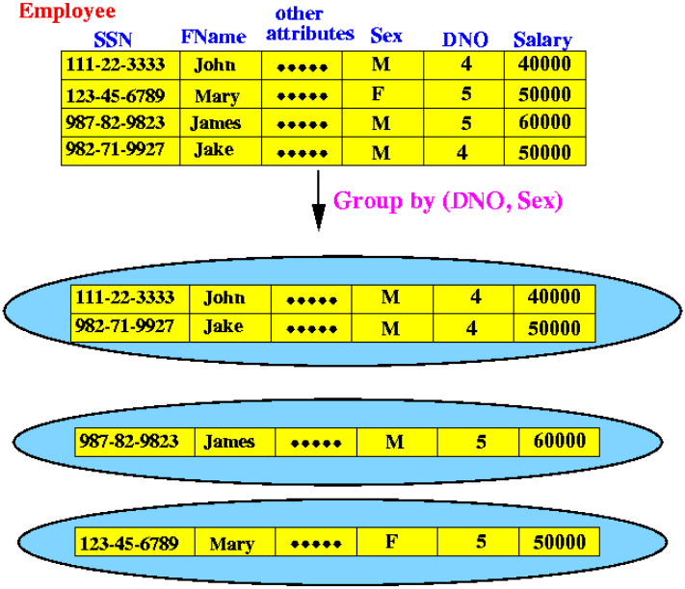
Another Example:
Grouping attribute: dno and sex

Slide 8
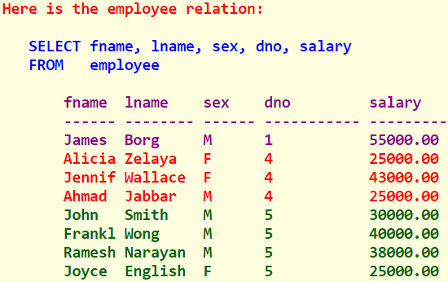
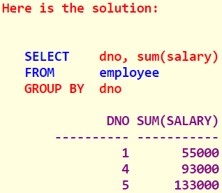
Forming Groups with Common Attribute Values: Grouping Attributes (cont.)
GROUP BY clause for this purpose
Syntax
Example:
For each department, find the total salary paid to employees of that department
SELECT ...
FROM relation-list
WHERE tuple-boolean-condition
GROUP BY grouping-attributes

Slide 9
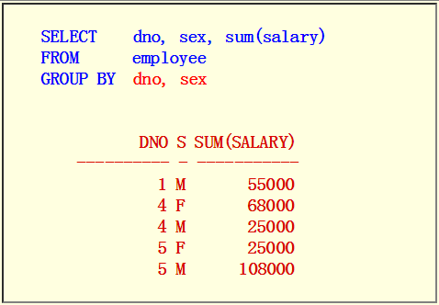
Grouping with Multiple Common Attribute Values
Query:
Find the total salary paid to male and female employees (separate total) for each department
Solution:

Slide 10
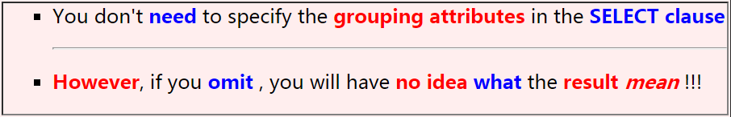
Note on Output Format
See an example first:
SUM(SALARY)
-------------------
25000
55000
108000
68000
25000
What does each row mean?
Group by What ?
SELECT sum(salary) /* Omit dno, sex */
FROM employee
GROUP BY dno, sex
You don't have a clue what each row mean...

Slide 11
Execution of an SQL Query with GROUP BY Clause
A query with a GROUP BY clause is processed as follows:
First, select the tuples that satisfies the tuple (WHERE) condition
Then, the selected tuples in step 1 are grouped based on their value in the grouping attributes
Finally, one or more aggregate functions is applied to the groups
Example:

Slide 12
How is the following query processed?
(1) The WHERE clause is processed first:
Output:
DNO SUM(SALARY)
---------- -----------
1 55000
4 68000
5 108000
SELECT dno, sum(salary)
FROM employee
WHERE sex = 'M'
GROUP BY dno
SSN DNO S SALARY
123456789 5 M 30000
333445555 5 M 40000
987654321 4 M 43000
666884444 5 M 38000
987987987 4 M 25000
888665555 1 M 55000aaaa
The complete Employee relation:
SSN DNO S SALARY
123456789 5 M 30000
333445555 5 M 40000
999887777 4 F 25000
987654321 4 M 43000
666884444 5 M 38000
453453453 5 F 25000
987987987 4 M 25000
888665555 1 M 55000
(2) Resulting tuples are grouped by the grouping attributes (dno):
(3) Apply the aggregate function(s) on each group
SSN DNO S SALARY
888665555 1 M 55000
987654321 4 M 43000
987987987 4 M 25000
123456789 5 M 30000
333445555 5 M 40000
666884444 5 M 38000
-----> (DNO=1) SUM = 55000
-----> (DNO=4) SUM = 68000
-----> (DNO=5) SUM = 108000

Slide 13
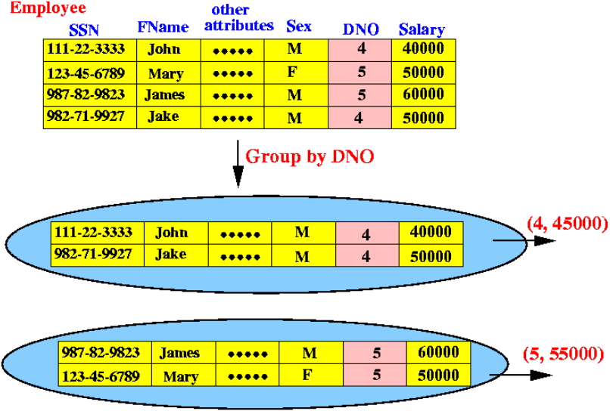
Effect of the GROUP BY on Common Attribute Values
Property:
After forming groups based on the grouping attributes, the attribute values other than the grouping attributes will be lost

Slide 14
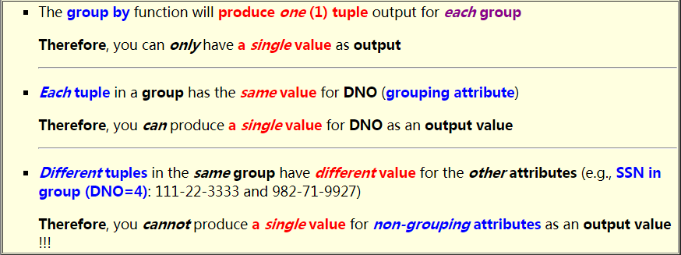
Effect of the GROUP BY on Common Attribute Values (cont.)
Why?

Slide 15
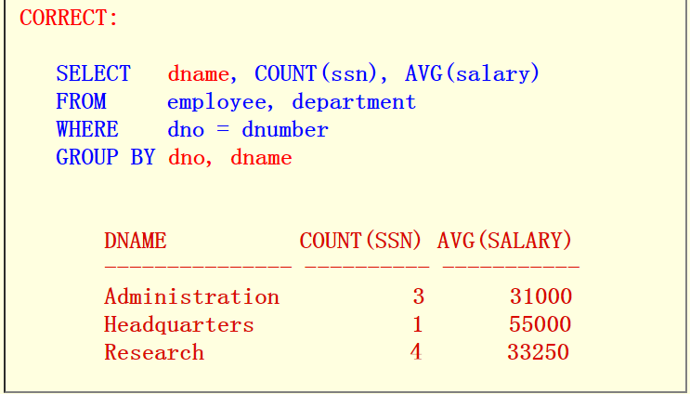
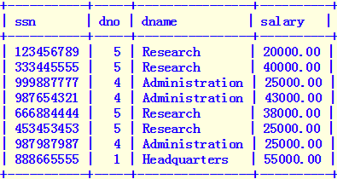
Examples of GROUP BY Queries
Query 1:
For each department, show the department NAME, number of employees and average salary paid to the employees in the department
Solution:
SELECT sssn, dno, dname, salary
FROM employee, department
WHERE dno=dnumber
SELECT dname, COUNT(ssn), AVG(salary)
FROM employee, department
WHERE dno = dnumber
GROUP BY dno
COUNT(SSN) AVG(salary)
4 33250
3 31000
1 55000
Wrong! dname must be a grouping attribute !!

Slide 16

Flashback: Data Independency
Physical data independence
You can change the structure of the physical data records without having to change the programs to access the new record structure
All you need to do is: provide a new (updated) data description (= meta data)
Logical data independence
Data is stored in one format (called the conceptual database schema), the database system can present the data in different ways to different users
The view of the data can be adapted to the need of the user
Notes:
to access the new record structure

Slide 17
Concept of a View in SQL
A view is a virtual relation that is derived from
Relations
Other virtual relations
Property of a virtual relation:
A virtual relation (= view) does not exist as in physical form
The tuples in a virtual relation (= view) are not stored physically in the database
The tuples in a virtual relation (= view) are computed as a temporary relation when the virtual relation is used

Slide 18
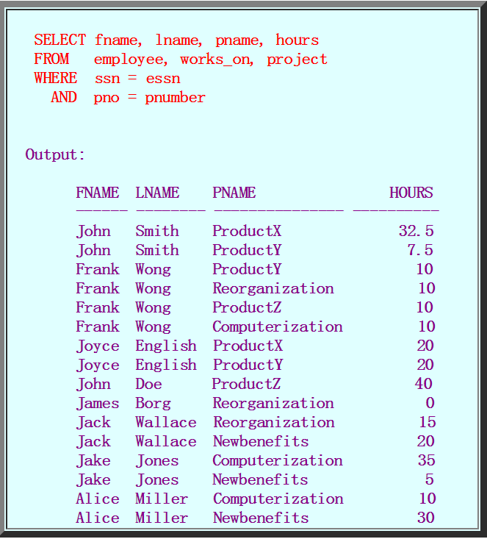

Example Temporary Relation
Suppose a secretary maintains a list of the activities on all employees
The list contains the following information
You could obtain the data using this SQL query
Question: How to find the activities of "John Smith"?

Slide 19
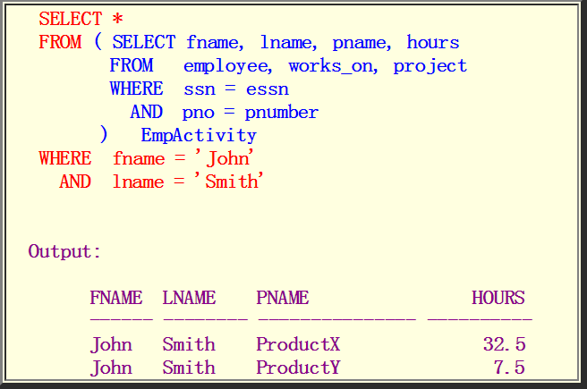
Example Temporary Relation (cont.)
To find the activities of "John Smith", we can use the following temporary relation construct:
The temporal relation EmpActivity is created on the fly !!!!

Slide 20
Creating View (Virtual Relations)
A view (= virtual relation) is defined using the CREATE VIEW command
A (virtual) table name (or view name)
A list of attribute names, and
A query to specify the contents of the view.
Example:
CREATE VIEW EmpActivity
AS
( SELECT Fname, Lname, Pname, Hours
FROM employee, works_on, project
WHERE ssn = essn
AND pno = pnumber
)
Results:
The CREATE VIEW command defines an virtual table (relation) called EmpActivity
This virtual table/relation will be construct when we use the EmpActivity relation in a query !!!
EmpActivity

Slide 21
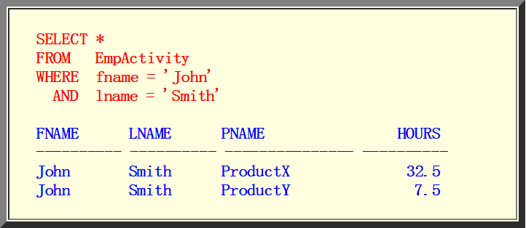
Creating View (Virtual Relations) (Example)
We can now specify SQL queries on a view—or virtual table—in the same way we specify queries involving base tables
Example: Find all activities of John Smith

Slide 22
Why Do We Introduce the Concept of View
Now thinking: why do we introduce the concept of view?
Simplify the specification of certain queries
Used as a security and authorization mechanism

Slide 23
Views as Authorization Mechanism
Views can be used to hide certain attributes or tuples from unauthorized users
Example: suppose a certain user is only allowed to see employee information for employees who work for department 5;
Another example: restrict a user to only see certain columns: the first name, last name, and address of an employee
CREATE VIEW DEPT5EMP
AS
( SELECT *
FROM EMPLOYEE
WHERE Dno = 5;
)
Grant the user the privilege to query the view but not the base table EMPLOYEE itself.
CREATE VIEW BASIC_EMP_DATA
AS
( SELECT Fname, Lname, Address
FROM EMPLOYEE;
)
Notes:
Thus by creating an appropriate view and granting certain users access to the view and not the base tables, they would be restricted to retrieving only the data specified in the view.

Slide 24
Keep View be Up-to-Date
A view is supposed to be always up-to-date
If we modify the tuples in the base tables on which the view is defined
The view must automatically reflect these changes
The view does not have to be realized or materialized at the time of view definition but rather at the time when we specify a query on the view
Responsibility of the DBMS and not the user
CREATE VIEW EmpActivity
AS
( SELECT fname, lname, pname, hours
FROM employee, works_on, project
WHERE ssn = essn
AND pno = pnumber
)

Slide 25
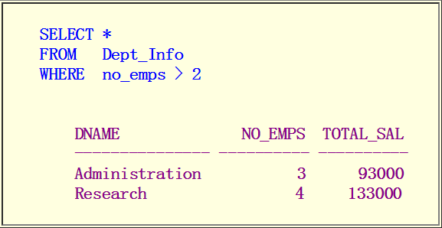
View is Computed on the fly
Consider the following view definition
Example query on this view:
Find all department with >2 employees:
CREATE VIEW Dept_Info(dname, no_emps, total_sal)
AS
( SELECT dname, count(ssn), sum(salary)
FROM department, employee
WHERE dnumber = dno
GROUP BY dname
)

Slide 26
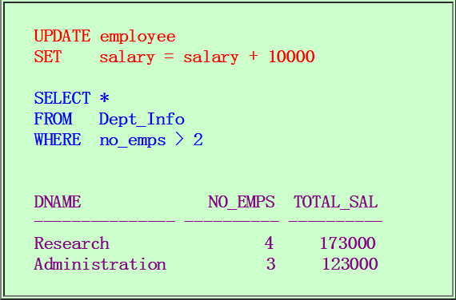
View is Computed on the fly (cont.)
Change the salary of employees:

Slide 27
Modifying Existing Relations: Altering and Dropping
Modifying the structure of an existing relation
After you have defined a relation using the CREATE TABLE command, you can still make changes to its structure
DROP TABLE
Deleting the definition of a table from the database schema
Syntax: DROP TABLE relation_name
The relation definition is removed, along with any tuples (data) that you have previously inserted....
Here is the difference between Drop and Delete

Slide 28
Modifying Existing Relations: Altering and Dropping (cont.)
Two types:
Example: if we no longer wish to keep track of dependents of employees in the COMPANY database, drop it:
1) DROP TABLE DEPENDENT CASCADE;
All constraints, views, and other elements that reference the table being dropped are also dropped automatically from the schema, along with the table itself.
2) DROP TABLE DEPENDENT RESTRICT;
A table is dropped only if it is not referenced in any constraints (for example, by foreign key definitions in another elation) or views (see Section 7.3) or by any other elements
Notes:
If CASCADE is chosen, all constraints and views that reference the column are dropped automatically from the schema, along with the column. If RESTRICT is chosen, the command is successful only if no views or constraints (or other schema elements) reference the column

Slide 29
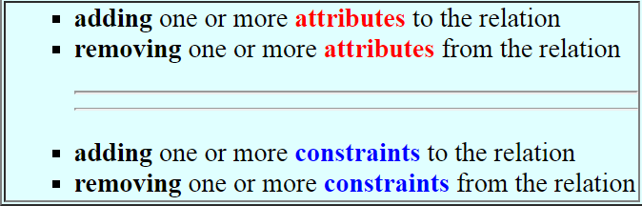
Modifying Existing Relations: Altering and Dropping (cont.)
ALTER TABLE: changing a relation schema.
SQL allows the owner of the database relation to change it by:
ALTER TABLE COMPANY.EMPLOYEE ADD COLUMN Job VARCHAR(12);
ALTER TABLE COMPANY.EMPLOYEE DROP COLUMN Address CASCADE;
Notes:
If CASCADE is chosen, all constraints and views that reference the column are dropped automatically from the schema, along with the column. If RESTRICT is chosen, the command is successful only if no views or constraints (or other schema elements) reference the column

Slide 30
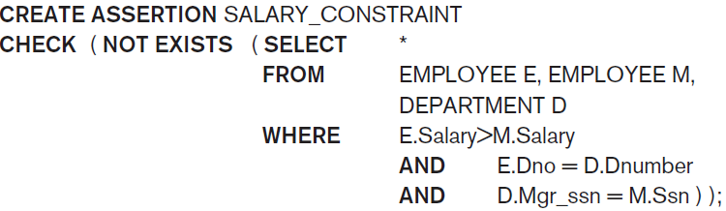
Create Assertion
CREATE ASSERTION
Used to specify additional types of constraints that are outside the scope of the built-in relational model constraints
Example: specify the constraint: the salary of an employee must not be greater than the salary of the manager of the department that the employee works for:
Notes:
These built-in constraints can be specified within the CREATE TABLE statement of SQL

Slide 31
Create Trigger
CREATE TRIGGER
Used to specify automatic actions that the database system will perform when certain events and conditions occur.
Example:
Suppose we want to check whenever an employee’s salary is greater than the salary of his or her direct supervisor
Trigger conditions: inserting a new employee record, changing an employee’s salary, or changing an employee’s supervisor
Action: suppose that the action to take would be to call an external stored procedure SALARY_VIOLATION, which will notify the supervisor.

Slide 32
Create Trigger (cont.)
The trigger could then be written as
CREATE TRIGGER SALARY_VIOLATION
BEFORE INSERT OR UPDATE OF SALARY, SUPERVISOR_SSN ON EMPLOYEE
FOR EACH ROW
WHEN ( NEW.SALARY > ( SELECT SALARY FROM EMPLOYEE
WHERE SSN = NEW.SUPERVISOR_SSN
)
)
INFORM_SUPERVISOR(NEW.Supervisor_ssn, NEW.Ssn );
ECA (Event, Condition, Action)

